Slide 1
Infobasic-1
September 2011
Notes:
© 2006 Capgemini - All rights reserved
0

Slide 2
Objective
At the end of this session, participants will
Know programming features of Infobasic
Know the various array types
Know how to program using various control structures

Slide 3
Why Infobasic?
Programming language used in T24
Has simple English like statement

Slide 4
Understanding Variables
How do we declare variables generally?
int score
Example : 45
Char name
Example : A
boolean result
TRUE or FALSE

Slide 5
Understanding Arrays
How do we store more than 1 character or a number in one variable?
Use arrays
How do we tell the array how many characters or numbers it should store
Char Name[10]
Array ‘name’ can store up to a maximum of 10 characters
Example : Temenos
0 1 2 3 4 5 6
Name[0] = T
Name[1] = E
Name[2] = M
Name[3] = E
Name[4] = N
Name[5] = O
Name[6] = S
C | A | P | G | E | M | I

Slide 6
Understanding Arrays
You don’t want your array to have a fixed length
You don’t want your array to be bound to a data type
Welcome to Dynamic Arrays In jBC

Slide 7
Understanding Arrays
You wish to store the string Temenos in a variable called ARR1
ARR1 = “Temenos”
You wish to store today’s date in a variable called ARR1
ARR1 = “160108”
You wish to store the number 134.67 in a variable called ARR1
ARR1 = 134.67
Can the variable ARR1 store all types of data and data of any length?

Slide 8
Dynamic Array in T24
How are we able to have variable length records?
Using dynamic arrays
How do we store values of multiple fields in one dynamic array
Using delimiters such as FM, VM and SM
ASCII Decimal Description
254 Field Marker
253 Value Marker
252 Sub-Value Marker
Field1FMField2FM Value1VMValue2VMValue3VMValue4FMField4FMSubValue1SMSubValue2FMField5

Slide 9
Understanding FM,VM and SM
1 Name | Capgemini Trg
2.1 Address | India
2.2 Address | UK
2.3 Address | Geneva
3.1 Course Category | Technical
4.1.1 Course Name | jBASE
4.1.2 Course Name | T24
3.2 Course Category | Functional
4.2.1 Course Name | Lending
4.2.2 Course Name | Financials
5 Free Text
6 Inputter | TRAINER.1
Single value field
Multi value field
Sub value field

Slide 10
Dynamic Array – Data Storage
Capgemini TrgFMIndiaVMUKVMGenevaFMTechnicalVMFunctionalFM
jBASESMT24VMLendingSMFinancialsFMFMTrainer.1
When a field does not contain any value, there will still be a FM to delimit and say that there is field that does not contain a value now.

Slide 11
Appending Value to an Array
Appending Values using FM
ArrayVar<-1> - Used to append values in an array using FM as delimiter
Example: Y.INFO<-1>=“Test Info”
Appending Values using VM
ArrayVar<FMPos,-1> - Used to append values to a position (Field) in an array using VM as delimiter
Example : R.CUS<EB.CUS.TEXT,-1>="THIS IS FROM TRAINIING“
Appending Values using SM
ArrayVar<FMPos,VMPos,-1> - Used to append values to a certain multi value position (VMPos) of a field in an array using SM as delimiter
Note: FMPos should always contain a valid field number/position.
Example : R.CUS<6,2,-1>=“No 50 Lake View Road, New York“

Slide 12
Dimensional Arrays
A dimensioned array is a group of dynamic arrays
How many dynamic arrays form a dimensioned array?
You can configure that
DIM ARR(5)
Dynamic Array 1
Dynamic Array 2
Dynamic Array 3
Dynamic Array 4
Dynamic Array 5

Slide 13
Initializing and Declaration – is there Difference
Generally, a variable is declared, initialized and then used
int score → Declaration
score = 0 → Initialization
if score > 100 then …… → Usage of the variable
In jBASE
Variables don’t have to be declared
It is a good practice to initialize the variable before using it
score = 0 →Initialization
If score > 100 then ……. → Usage of the variable

Slide 14
Programming Execution
Infobasic Programming
Program
Subroutine
Execute in database prompt
Execute within T24

Slide 15
Difference
PROGRAM | SUBROUTINE
Executed in jShell prompt | Executed in T24
Can be invoked by itself in jBase | Can be invoked only through program in jBase
Executables stored in .bin | Executables stored in .lib
PGM entry not required | PGM entry required

Slide 16
Programming flow
Write Program/Subroutine
Compile and catalog the Program/Subroutine
Execute the Program/Subroutine

Slide 17
Structure of Program
*Comments
PROGRAM <Program name>
Statement 1
Statement 2
Statement 3
END

Slide 18
Structure of Subroutine
*Comments
SUBROUTINE <Subroutine name>
Statement 1
Statement 2
Statement 3
RETURN
END

Slide 19
Program Compilation
Process of converting source code into object code
Use BASIC from jShell prompt
Example: BASIC XXX.BP TEST.PRG
On compilation, file prefixed with $ will be created and stored in same directory
Example: $TEST.PRG

Slide 20
Program Cataloging
Process of converting object code into main program executables
CATALOG – Command used to catalog from jShell prompt
Example: CATALOG XXX.BP TEST.PRG
DECATALOG – Command used to remove object files
Example: DECATALOG XXX.BP TEST.PRG

Slide 21
Compilation Error
When error appears at compilation stage
Solve error in the Program/Subroutine & Compile again
OR
Use DEBUG in Program/Subroutine, after solving syntax error
Compile again using ‘EB.COMPILE Filename Program/Subroutine name –D’
NOTE: DEBUG enables us to view value of variables (/variable), while running the Program/Subroutine

Slide 22

Solution
Error appears, when program/subroutine is not compiled

Slide 23
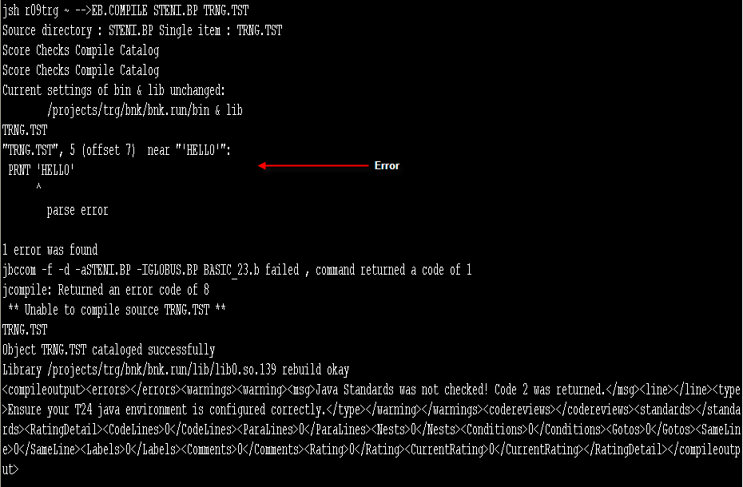
Solution
Bug in program causes error during compilation
Solve the error & compile again

Slide 24
Compiling And Cataloguing Routines
EB.COMPILE TRG.BP TRG.RTN1
COMPILE
CATALOG
Check for errors
Check JBCDEV_LIB = $HOME/lib
If Yes
Exit
If No
If Yes
Produce object code $TRG.RTN1
Check whether place is there
If No
Exit
TRG.BP
$TRG.RTN1
If Yes
Notes:
Compilation is the process of converting source code into object code.
BASIC is the command used to compile from jShell prompt.
Example:
BASIC XXX.BP TEST.PRG
As a result of compilation a file with prefix $ will be created and stored in the same directory.
Example:
$TEST.PRG
Catalog is the process of converting object code into main program executables.
CATALOG is the command used to catalog from jShell prompt.
Example:
CATALOG XXX.BP TEST.PRG
DECATALOG command can be used to remove object files.

Slide 25
Execution
Program
Execute in database (jshell) prompt
Enter Program name in database prompt & press Enter key
Subroutine
Execute in Globus prompt
Log into T24 classical mode
Enter Subroutine name in Globus prompt & press Enter key
NOTE: For Subroutine execution in Globus prompt, make a PGM entry of the program with type as M

Slide 26
Executing Programs
Go to database prompt
jsh..> TRG.PRG1
PATH =.;$HOME/globusbin;$HOME/bin;$PATH
Execute the program

Slide 27
Executing Routines
Login into T24
Make an entry in the PGM.FILE
At the command line
TRG.RTN1
JBCOBJECTLIST - $HOME/globuslib;
$HOME/lib
Execute the routine
Notes:
RUN is the command used to execute the program executables.
We can directly execute by entering <program name> in jShell prompt if it is cataloged.
EXECUTE and PERFORM are the command used to execute Program/JQL commands inside the Program.
ENTER is the command that passes the control to another program and the control will not come back to the calling program.

Slide 28
Example
Write a simple program to display ‘HELLO WORLD’

Slide 29
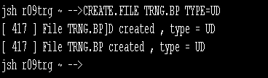
Solution
Create a file as shown, to store the program
Use the command:
CREATE.FILE filename TYPE=UD

Slide 30
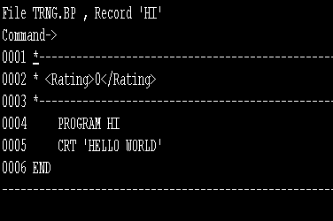
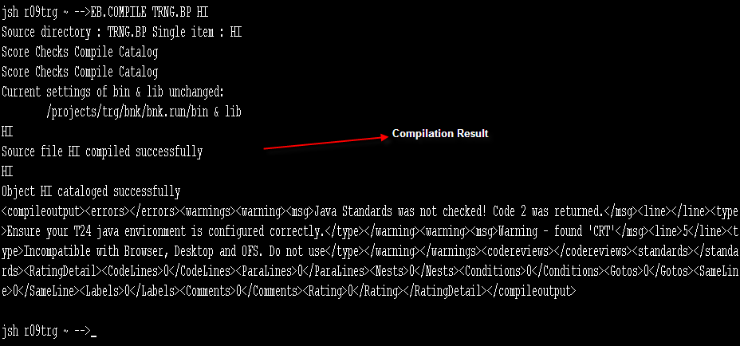
Solution
Type jsh > JED <filename> <programname>
Enter the code to display ‘HELLO WORLD’
Type jsh > EB.COMPILE <filename> <programname>

Slide 31

Solution
Output appears as shown

Slide 32
Example
Create a routine with parameter, to
Pass two values and
Returns multiplication of two values in variable

Slide 33
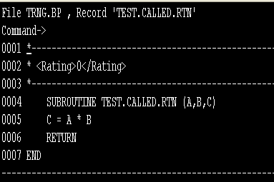
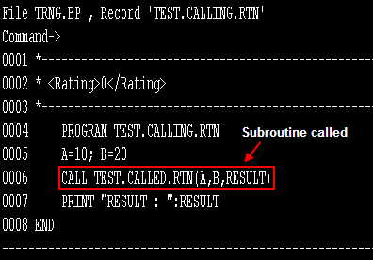
Solution
Create a program and a subroutine as shown in the screen shots

Slide 34
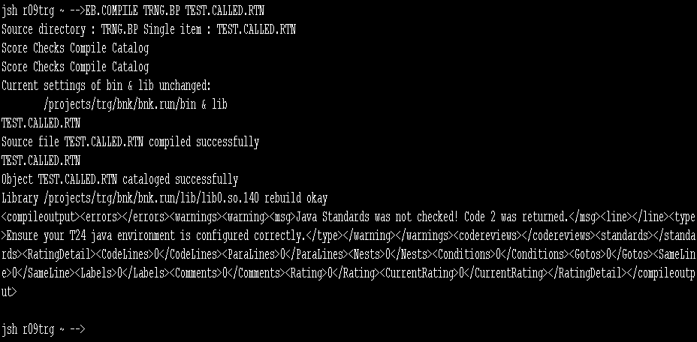
Solution
Compile the subroutine

Slide 35
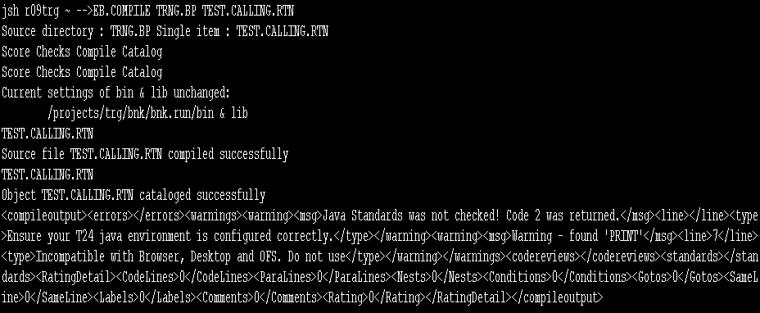
Solution
Compile the program

Slide 36

Solution
While running/executing the program the routine is called”
Resulting, output appears as shown

Slide 37
Control structures
IF..THEN
IF..END ELSE..END
CASE
FOR
LOOP WHILE
LOOP REPEAT

Slide 38
IF..ELSE Structure
IF <condition> THEN
<statements>
END ELSE
<statements>
END
Notes:
To determine the operations to be run following either the true or false result of the expression
If the expression on the THEN clause is true,
Statements following the ‘THEN’ clause are executed,
Otherwise
Statements following the ‘ELSE’ clause are executed

Slide 39
Example
Write a program to print “No. is greater than 7” else to print “No. is smaller than 7”

Slide 40
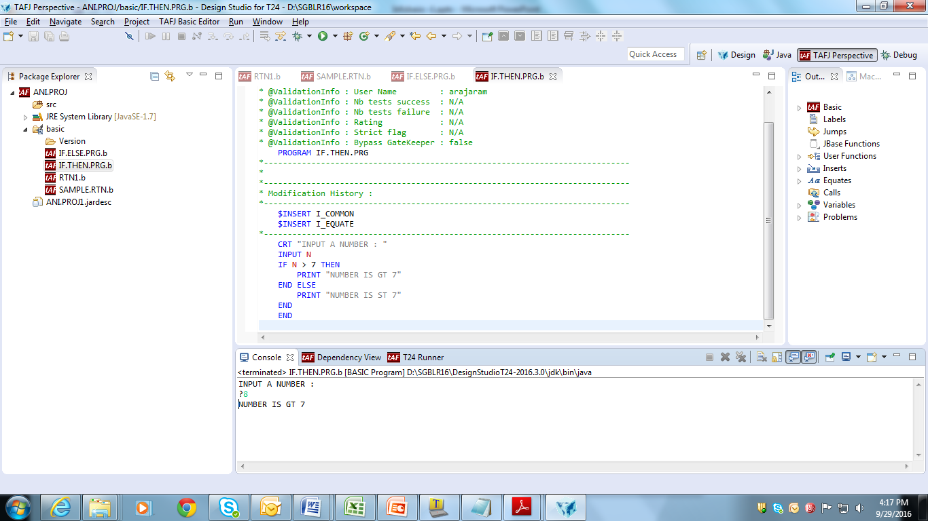
Solution
Write a program as shown

Slide 41
Nested IF Structure
IF expression THEN
statements
END ELSE
IF expression THEN
statements
END ELSE
statements
END
END
Notes:
IF-THEN-ELSE Structure
The IF clause is used to determine the operations to be run following either the true or false result of the statement.
If the expression on the THEN clause is true, the statements following the ‘THEN’ clause are executed, otherwise the statements following the ‘ELSE’ clause are executed.
IF <condition> THEN
<statements>
END
ELSE
<statements>
END

Slide 42
Example
Write a program to display
“No. GT 100” – when input number is greater than 100
“No. GT 50 and LT 100” - when input number is greater than 50 and less than 100
“No. LT 50” – when input number is less than 50

Slide 43
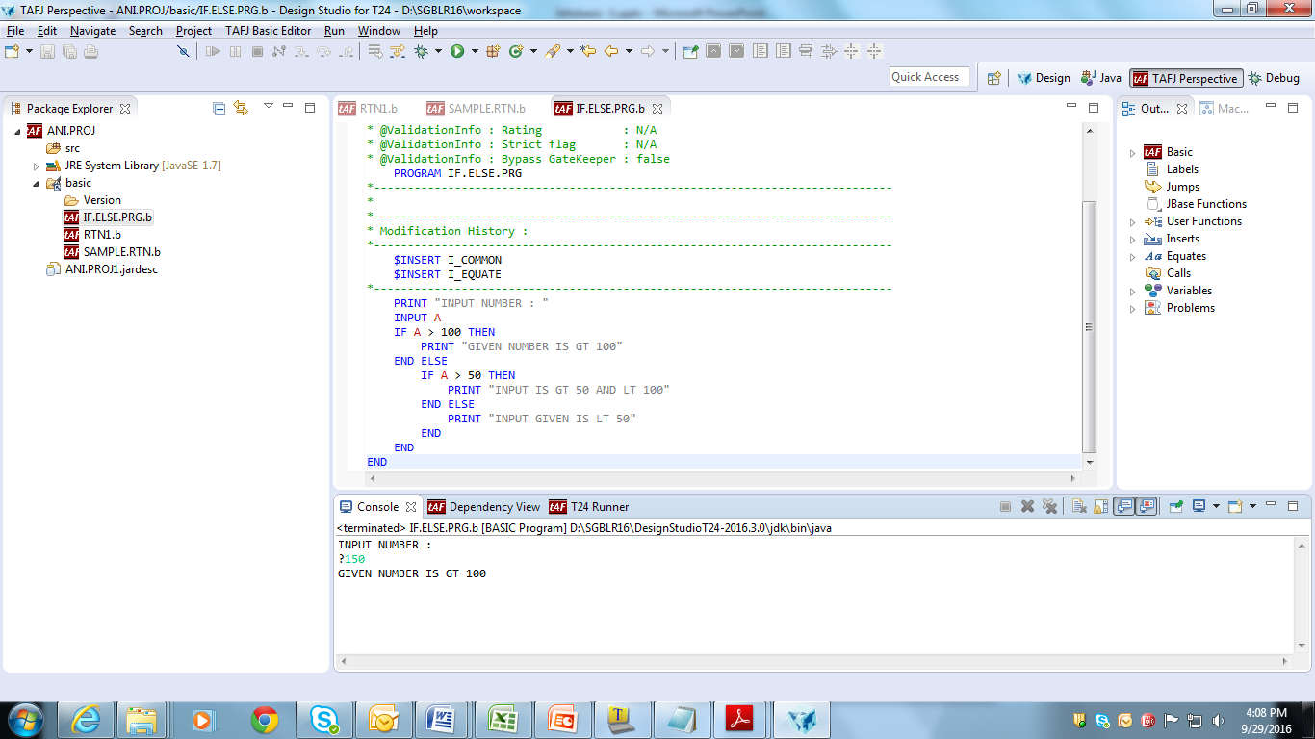
Solution

Slide 44
CASE Structure
BEGIN CASE
CASE <variable> = <value>
<statements>
CASE <variable> = <value>
<statements>
CASE <variable> = <value>
<statements>
CASE 1
<statements>
END CASE

Slide 45
Control Flow
Expressions/statements evaluated in sequential order
When a true expression is encountered,
Corresponding statements are executed and control exits from the CASE structure
When no true expression is encountered,
Statements under CASE 1 are executed and control exits from the CASE structure
In the absence of CASE 1 expression, then no statements are executed and control exits from the CASE structure

Slide 46
Example
Write a program to print the name, if the given choice is equal to (or matches) the first two characters of the given name, else print the message “No match”

Slide 47
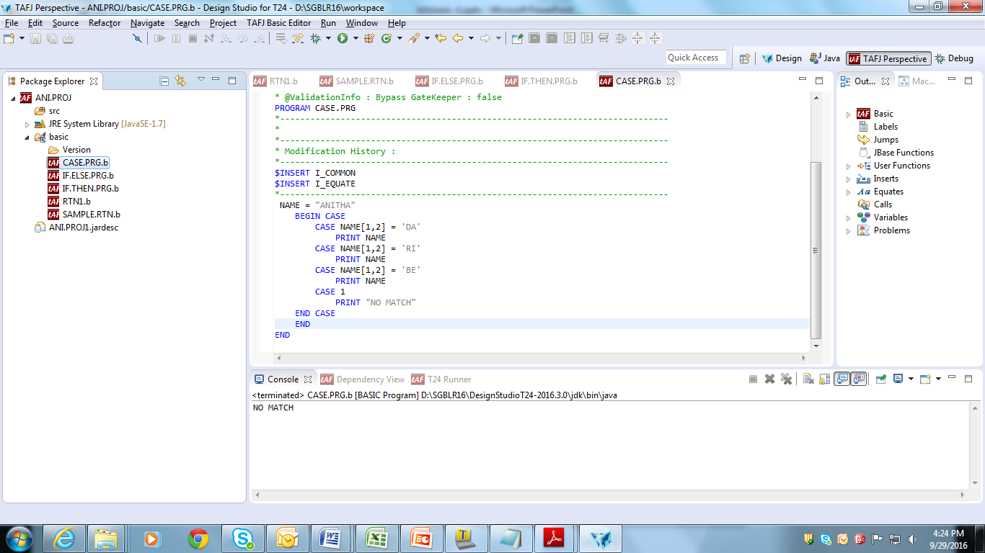
Solution
Write a program as shown

Slide 48
FOR-NEXT Structure
FOR <variable> = <initial value> To <maximum value>
<statements>
NEXT <variablename>

Slide 49
Example
Write a program to print text ‘Counter Variable’ in loop of 10 times

Slide 50
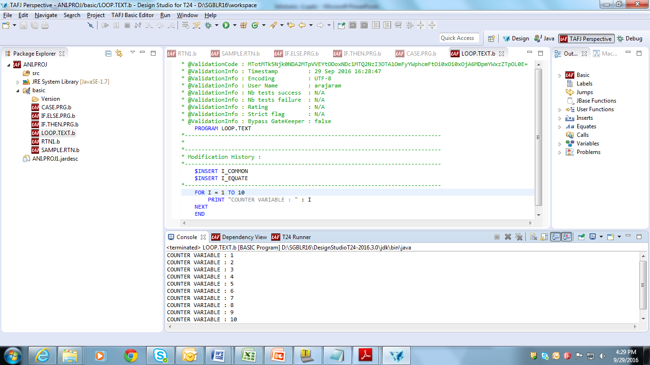
Solution
Write a program to print text in loop as shown

Slide 51
Workshop
Write a program to print text ‘Counter Variable’ for a fixed number of times

Slide 52
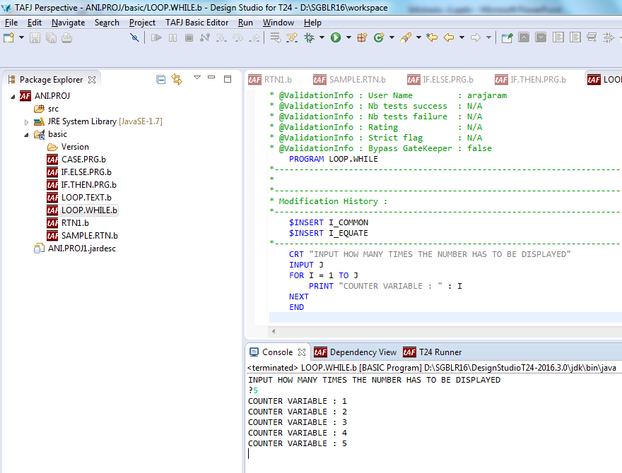
Solution
Write a program as shown: to receive the number of times the text has to be printed & then form loop to print the text

Slide 53
Example
Write a program to print the text “Counter Variable:” followed by only odd numbers, till 10

Slide 54
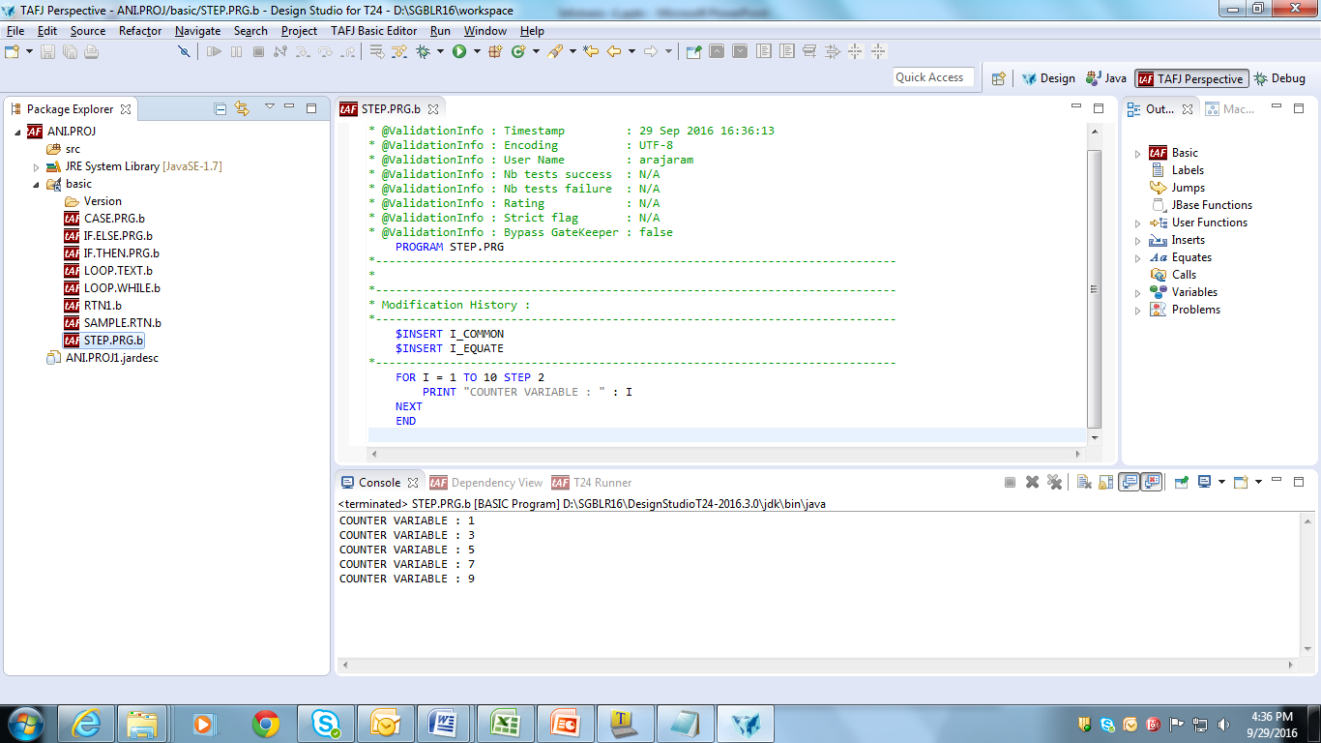
Solution
Write a program to print the text along with odd number, up to 10

Slide 55
LOOP-WHILE structure
LOOP <statements>
WHILE/UNTIL <expression>
<statement>
REPEAT

Slide 56
Example
Write a program to print incremental of numbers, using while condition

Slide 57
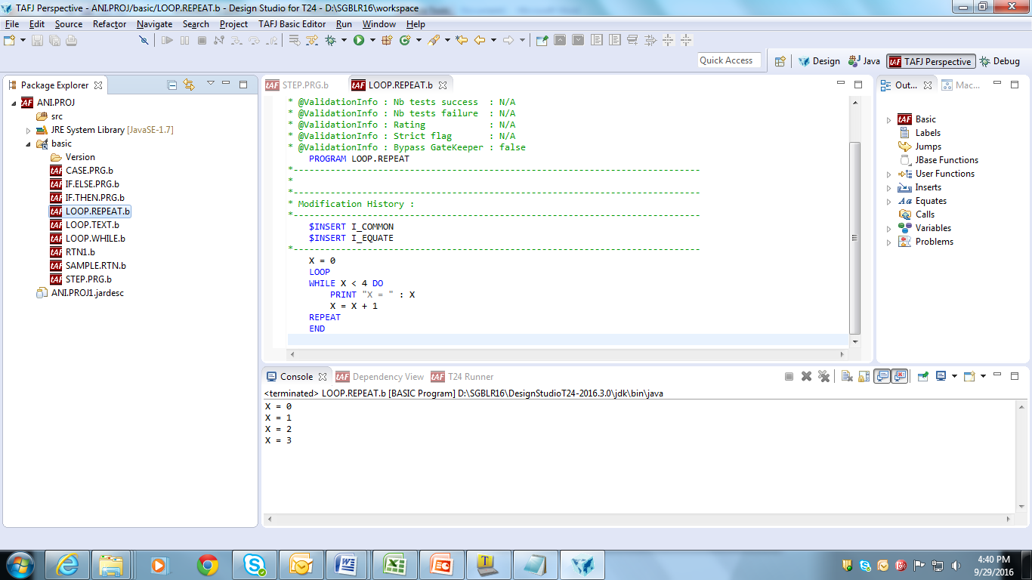
Solution
Write a program as shown, to print incremental of numbers less than ‘4’

Slide 58
LOOP-REPEAT structure
Loop <statement>
UNTIL <expression>
<statement>
REPEAT

Slide 59
Example
Write a program to print incremental of numbers, using until condition

Slide 60
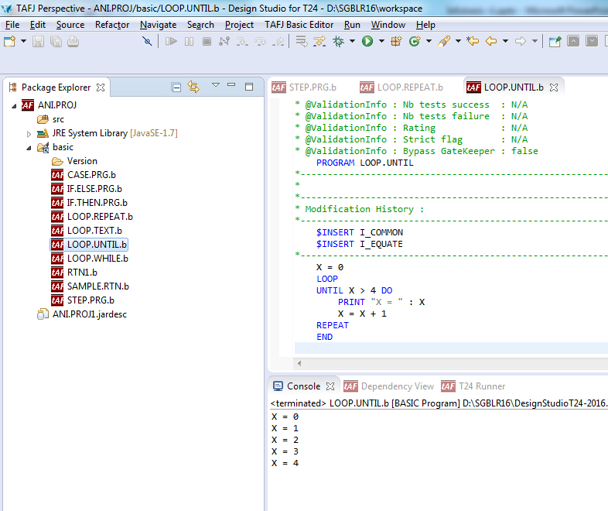
Solution
Write a program to print number until 4 is reached

Slide 61
Difference
LOOP-WHILE | LOOP-UNTIL-REPEAT
Facilitates repeated execution of a set of statements, control exits from structure when condition evaluates to false | Facilitates repeated execution of a set of statements, control exits from structure when condition evaluates to true

Slide 62


www.capgemini.com/financialservices

